Slide 1
Keys

Slide 2
Keys?
A DBMS key is an attribute or set of an attribute which helps you to identify a row(tuple) in a relation(table).
They allow you to find the relation between two tables.
Keys help you uniquely identify a row in a table by a combination of one or more columns in that table.

Slide 3
Why we need a Key?
Keys help you to identify any row of data in a table.
In a real-world application, a table could contain thousands of records. Moreover, the records could be duplicated.
Keys ensure that you can uniquely identify a table record despite these challenges.
Allows you to establish a relationship between and identify the relation between tables. Help you to enforce identity and integrity in the relationship.

Slide 4
Keys in Database Management System
Super Key
Primary Key
Candidate Key
Alternate Key
Foreign Key
Composite Key
Surrogate Key/ Artificial Key

Slide 5
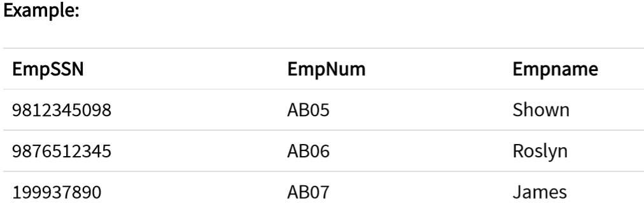
Super key?
A superkey is a group of single or multiple keys which identifies rows in a table.
A Super key may have additional attributes that are not needed for unique identification.
In this example, EmpSSN, EmpNum and Empname are superkeys.

Slide 6
Primary Key?
A column or group of columns in a table which helps us to uniquely identifies every row in that table is called a primary key.
This can't be a duplicate. The same value can't appear more than once in the table.
Rules for defining Primary key:
Two rows can't have the same primary key value.
It must for every row to have a primary key value.
The primary key field cannot be null.
The value in a primary key column can carefully be modified or updated, considering that if any foreign key refers to that primary key.

Slide 7
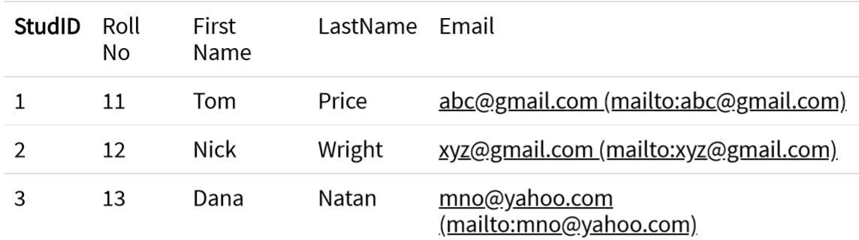
Example:
In the following example, StudID is a Primary Key.

Slide 8

Alternate key?
All the keys which are not primary key are called an alternate key.
It is a candidate key which is currently not the primary key.
However, A table may have single or multiple choices for the primary key.
Example: In this table, StudID, Roll No, Email are qualified to become a primary key. But since StudID is the primary key, Roll No, Email becomes the alternative key.

Slide 9
Candidate Key?
A super key with no repeated attribute is called candidate key.
The Primary key should be selected from the candidate keys. Every table must have at least a single candidate key.
Properties of Candidate key:
It must contain unique values
Candidate key may have multiple attributes
Must not contain null values
It should contain minimum fields to ensure uniqueness
Uniquely identify each record in a table

Slide 10
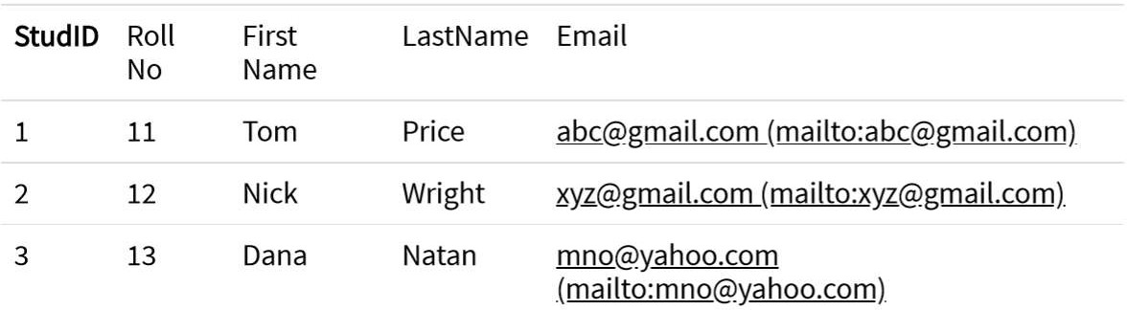
Candidate Key?
Example: In the given table Stud ID, Roll No, and email are candidate keys which help us to uniquely identify the student record in the table.

Slide 11
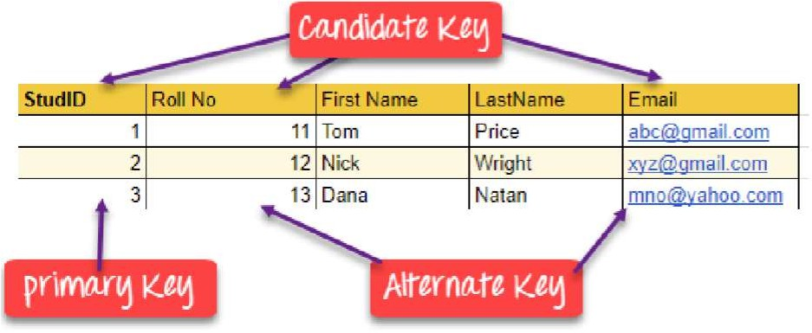

Slide 12
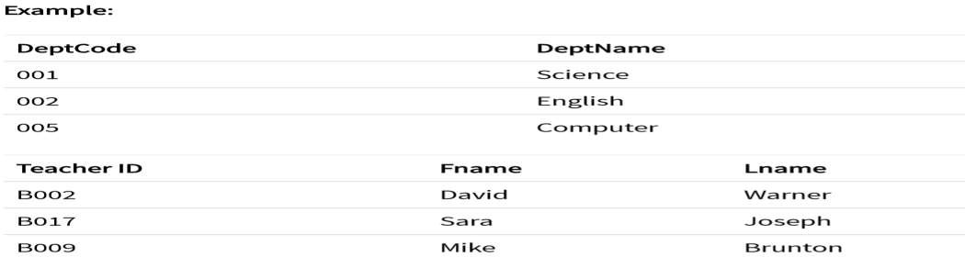
Foreign key?
A foreign key is a column which is added to create a relationship with another table.
Foreign keys help us to maintain data integrity and also allows navigation between two different instances of an entity.
Every relationship in the model needs to be supported by a foreign key.

Slide 13
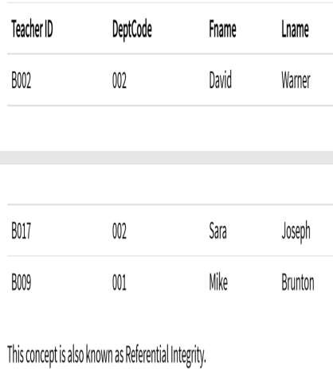
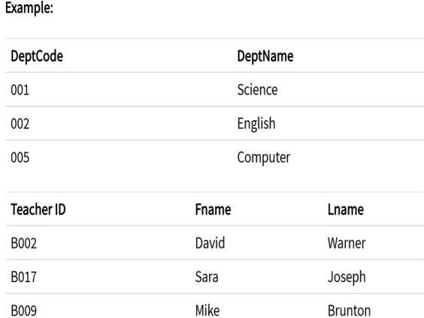
In this example, we have two table, teacher and department in a school. However, there is no way to see which search work in which department.
In this table, adding the foreign key in Deptcode to the Teacher, we can create a relationship between the two tables.
Teacher with DeptCode
teacher and department tables

Slide 14
Composite key?
A key which has multiple attributes to uniquely identify rows in a table is called a
composite key.
It is type of Compound key has many fields which allow you to uniquely recognize a specific record.
It is possible that each column may be not unique by itself within the database.
However, when combined with the other column or columns, the combination of composite keys become unique.

Slide 15
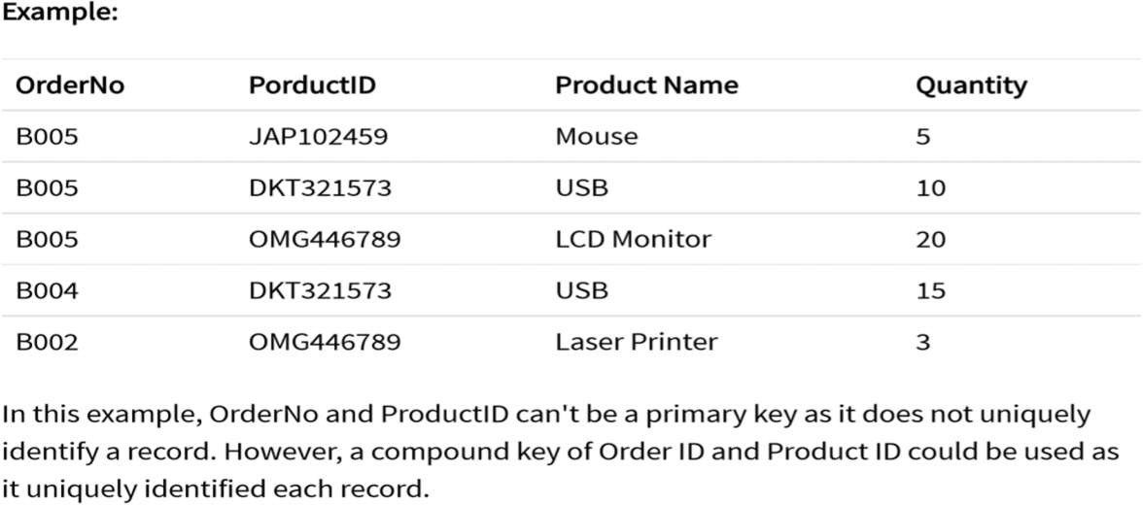
Composite or Compound key example

Slide 16
Surrogate Key/Artificial key ?
An artificial key which aims to uniquely identify each record is called a
surrogate key.
These kind of key are unique because they are created when you don't have
any natural primary key.
They do not lend any meaning to the data in the table.
Surrogate key is usually an integer.

Slide 17
Student Table
Student_Name | Class
Amit | CSE
Amit | CSE
Rohit | ENC
Student Table with Sr_No as Surrogate Key/Artificial key ?
Sr_No | Student_Name | Class
1 | Amit | CSE
2 | Amit | CSE
3 | Rohit | ENC

Slide 18
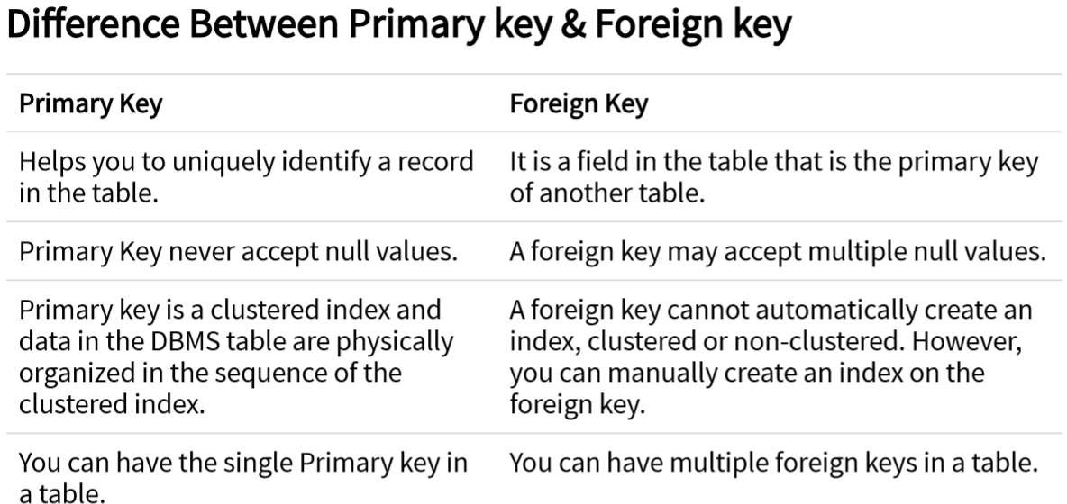

Slide 19
Thank You

